Slide 1


—
Administrative Law 2025
Week 7 Tutorial Introduction to Judicial Review
Dr Richard Taylor
Lecturer, School of Law

Slide 2
Assessment 2 – Due Soon
Assessment name: Memorandum of Advice
Weight: 30%
Assignment due date: End week 8 – Sunday 21 September 2025
Length: 1,800 words
Details: Memo of Advice in relation to various issue raised – See Canvas Assignment 2 for more details
Queries: If you have any questions or comments are require any clarification of the options or the nature of the task, please enquire in the early stages of preparing your submission.
Notes:
Australia no bill of rights
Extra important admin law often only avenue of redress

Slide 3
Agenda
Hypothetical
What are ‘grounds of review?
01
02
Get your thinking about a problem to be solved
Introduction to the concept
Error of Law vs Fact
Delegation & Agency
03
04
Highlights differences and substantial areas of overlap
In what circumstances is this allowable
Cases
Problem Questions
05
06
Overview of case law
Questions to prepare for assessment
Notes:
Australia no bill of rights
Extra important admin law often only avenue of redress

Slide 4
Administrative Law in the News [To be updated each week]
Administrative Law –LAW1023

Slide 5

Acting beyond power - ultra vires
Notes:
Australia no bill of rights
Extra important admin law often only avenue of redress

Slide 6
Practice Question
There may be a chain of enactments which give rise to the power to make a particular decision. Let us take the following hypothetical example.
The Forests Act 1958 (Vic)
  The Governor in Council may make regulations regarding the issue of licences to fell and remove timber from Crown land.
Regulation made by the Governor in Council
  The Minister for Forests may issue licences to fell and remove timber on Crown land or on any other land in Victoria which the Minister by notice in the Government Gazette declares to be Crown land.
Decision
  The Minister by notice in the Government Gazette declared certain land in Victoria to be Crown land.
  He then issued a licence to Ace Timber Products Ltd to fell and remove timber from the land.
Administrative Law –LAW1023

Slide 7
Practice Question
If there is a challenge to the Minister’s decision the court would need to consider whether the regulation that was made was within the power granted by the statute the Minister’s decision was within the power granted by the regulation.
If the answer to either question is “no” the Minister’s decision may be invalid.
In the example given, was the decision by the Minister within the power given by the regulation?
In the example given, was the decision by the Minister within the power given by the Statute?
Administrative Law –LAW1023

Slide 8
Practice: Interpretation Question
LOCAL GOVERNMENT ACT 1989 - SECT 111
Power to make local laws (1) A Council may make local laws for or with respect to any act, matter or thing in respect of which the Council has a function or power under this or any other Act.
LOCAL GOVERNMENT ACT 1989 - SECT 113
Permits, licences, fees and charges (1) A local law may—
(a) provide that a Council may by resolution determine a fee, charge, fare or rent in relation to any property, undertaking, goods, service or other act, matter or thing; and
(b) prescribe, regulate or determine the purposes for which and the conditions on which a Council may—
(i) grant a permit, licence, authority or registration; or
(ii) perform or supply a service; or
(iii) supply any goods or information; and
(c) prescribe the manner in which an application may be made for a permit, licence, authority or registration; and
(d) prescribe the fee which is payable for the granting, renewal or transfer of a permit, licence, authority or registration.
Administrative Law –LAW1023

Slide 9
Local Government Act 1989 (continued)
LOCAL GOVERNMENT ACT 1989 - SECT 114
DelegationsA local law may—
(a) confer a discretionary authority or impose a duty on a specified person or body or a specified class of persons and bodies; and
LOCAL GOVERNMENT ACT 1989 - SECT 115
Penalties (1) A local law may—
(a) prescribe a penalty not exceeding 20 penalty units for a contravention of a local law; and
LOCAL GOVERNMENT ACT 1989 - SECT 224
Authorised officersS. 224(1) amended by No. 125/1993 s. 26(2).
(1) A Council may appoint any person other than a Councillor to be an authorised officer for the purposes of the administration and enforcement of any Act, regulations or local laws which relate to the functions and powers of the Council.
Administrative Law –LAW1023

Slide 10
LOCAL GOVERNMENT ACT 1989 - SCHEDULE 8
Schedule 8—Provisions with respect to local laws
Without derogating from any other principles the following apply to local laws:
1 A local law must—
(e) wherever appropriate, set performance standards rather than prescribe detailed requirements as to the manner in which those standards shall be achieved;
2 A local law must not—
(b) without clear and express authority in the enabling Act—
(i) have any retrospective effect;
(ii) impose any tax or fee, or any fine, imprisonment or other penalty;
(iii) purport to shift the onus of proof to a person accused of an offence;
(iv) provide for any further delegation of powers delegated by the Act;
(c) be inconsistent with the principles, objectives or intent of the enabling Act;
(d) make unusual or unexpected use of the powers conferred by the Act under which the local law is made having regard to the general objectives, intention or principles of that Act;
(e) embody principles of major substance or controversy or contain any matter which principles or matter should properly be dealt with by an Act and not by subordinate legislation;
(f) unduly trespass on rights and liberties of the person previously established by law;
(g) unduly make rights and liberties of the person dependent upon administrative and not upon judicial decisions;
(h) be inconsistent with principles of justice and fairness;
(i) duplicate, overlap or conflict with other statutory rules or legislation;
Administrative Law –LAW1023

Slide 11
Discussion problem (Part 1)
Proposed amendments to Activities Local Law 2009
  Amendment to Camping in public places 2.8
    Unless in accordance with a permit, a person must not camp in or on any public place in a vehicle, tent, caravan or any type of temporary or provisional form of accommodation.
  Addition of 2.12 Unattended item in a Public Place
    2.12.1 Unless in accordance with a permit, a person must not leave any item unattended in a public place.
    2.12.2 If any item is left unattended in contravention of this Local Law, an authorised officer may confiscate and impound the item in accordance with this clause.
    2.12.3 Any item confiscated and impounded under clause 2.12.2 will be returned to its owner on payment of any fee or charge prescribed by the Council for its release.
    2.12.4 If the owner of the item has not paid any fee or charge required for its release, the Council may sell, destroy or give away the item.
    2.12.5 Before exercising the power conferred by clause 2.12.4, the Council must take reasonable steps to notify the owner of the item that the item has been impounded and may be sold, destroyed or given away unless the specified fee or charge is paid within 14 days.
Administrative Law –LAW1023

Slide 12
Problem questions – Assume the amendments passed
Where does the Council get its power to enact this by-law?
What procedural requirements does the Council need to go through to enact this by-law?
Can the Council impose penalties? What limits are there on this power?
Can dispute the validity of a by-law? How would you do that?
Administrative Law –LAW1023

Slide 13
Problem questions –Refer to the Local Government Act 1989
Mary is a 17 year old homeless girl. She has a mattress and bag full of clothes. She was sleeping near the rail tracks on Spencer Street when a local council officer came and issued her a fine.
Can Mary seek judicial review? On what grounds?
Remember what jurisdiction the Local Government Act relates to and consider today’s class only
Can the Charter help?
Where does the Council get its power to enact this by-law?
What procedural requirements does the Council need to go through to enact this by-law?
Can the Council impose penalties? What limits are there on this power?
Can dispute the validity of a by-law? How would you do that?
Administrative Law –LAW1023

Slide 14
Questions
1. What are grounds of review?
a. What are some examples?
b. Where are the grounds listed in the Administrative Decisions Judicial Review 1977 (Cth) (ADJR)?
c. Why are grounds so important?
d. How do they reflect some of the principles discussed.
2. What is the difference between an error of law and an error of fact?
a. How was this reflected in Hedari v Minister for Immigration and Border Protection [2020] FCA 298
3. What does it mean to act beyond power?
a. Why is this so important a ground?
b. Explain this in the context of our previous consideration of Entick v Carrington (1765) 19 St Tr 1030
c. What are some other relevant cases?
d. Why is statutory interpretation so important for this ground?
e. What is a necessary or convenient clause?
Notes:
Australia no bill of rights
Extra important admin law often only avenue of redress

Slide 15
Grounding decisions in authority
The making of an administrative decision must have its origin in law (legislation) which grants the power exercised. If it does not, the exercise of such power is said to be ultra vires—that is, it is outside the powers granted by the relevant legislation, and thus, invalid.
A power, for example, to grant a licence to drive a taxi, does not authorise the granting of a licence to drive a truck. The granting of a licence for the latter purpose would clearly be outside the ambit of the statute, and thus, invalid because it exceeds the power intended to be given by that statute.
Notes:
Australia no bill of rights
Extra important admin law often only avenue of redress

Slide 16
Beyond power
Parliament and other democratically elected bodies pass statutes giving important powers to decision makers (eg. To issue control orders). It is expected that those decision makers will act within the remit of that statute. But sometimes, they can act outside the remit of the statute, in 3 ways:
If they exercise their power in an unauthorised fashion (London County Council v AG (1902), or act beyond the scope of the statute;
If they disregard or fail to comply with an express procedural requirement; or
If they exercise improper delegation of authority i.e. the person who exercises the power is not the person to whom the power was conferred.
These 3 ways are termed narrow ultra vires or narrow jurisdictional error. They are named as such because the common law has recognised them as the more extreme sorts of errors, leading to invalidity of the decisions.
Notes:
Australia no bill of rights
Extra important admin law often only avenue of redress

Slide 17



What are the grounds of review?
Common Law
The basis for arguing that the court should grant relief are the grounds for arguing that a decision is affected by a reviewable error
– “an error of law”
– “ a ground for review”
Common law grounds/constitutional grounds/statutory grounds contain substantial overlap
Constitution
Statute
Administrative Law –LAW1023

Slide 18

Grounds of review
‘Grounds of review’ so called because they encapsulate the ways in which decision makers might act without lawful authority (or contrary to the terms of their authority)
The Common Law grounds of review have now been essentially codified in the ADJR Act. Generally in parallel*.
*Note there are two ADJR Act grounds– ‘error of law’ and ‘no evidence’ –that are catchall provisions and are different from common law grounds
Administrative Law –LAW1023

Slide 19
Broad categories of grounds (not fixed)
Acting beyond power
Factual errors
Disregard of express procedural requirement
Improper delegation
Failure to take account on mandatory considerations
Failure to afford natural justice
Improper purpose
Fraud/Bad Faith
Fettering of discretion;
Failure to exercise discretion;
Unreasonableness;
Irrationality
No evidence;
Administrative Law –LAW1023

Slide 20

Statutory judicial review – ADJR Act (Recall)
Section 5(1) – Grounds:
Breach of rules of natural justice
Required procedures not observed
No jurisdiction (jurisdictional error)
Decision not authorised by the enactment
Improper exercise of power (see further s 5(2))
Error of law whether or not on the record
Fraud
No evidence (see further s 5(3))
j) Contrary to law
There is no (i)! This appears to have been a quirk in the drafting process – it wasn’t removed by an amendment – appears it simply never existed.
Administrative Law –LAW1023

Slide 21

Statutory judicial review – ADJR Act (Recall)
Section 5(2) – Improper exercise of power
Irrelevant consideration(s)
Failure to take into account relevant consideration(s)
Purpose other than statutory one
Bad faith
Exercise of personal discretionary power under direction of another
Failing to take into account merits of particular case
Wednesbury unreasonableness
Uncertain result
j) “Any other exercise of a power in a way that constitutes abuse of the power”
“For instance, on the planet Earth, man had always assumed that he was more intelligent than dolphins because he had achieved so much—the wheel, New York, wars and so on—whilst all the dolphins had ever done was muck about in the water having a good time. But conversely, the dolphins had always believed that they were far more intelligent than man—for precisely the same reasons.”
Administrative Law –LAW1023

Slide 22

Statutory judicial review – ADJR Act
Section 5(3) – No Evidence
No evidence from which administrator can be reasonably satisfied that ‘particular matter was established’
Decision based on evidence of fact that did not exist
Administrative Law –LAW1023

Slide 23

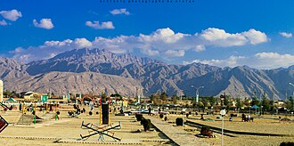
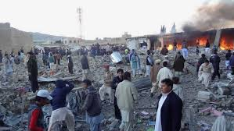
Hedari v Minister for Immigration and Border Protection [2020] FCA 298
Mr Hedari granted a protection visa and citizenship
Wife and children applied for partner visas (but had used apparently fake documents)
Refused by Minister’s delegate (no compelling circumstances to justify the grant of the visa)
Family sought review in AAT. AAT supported decision of the Minister on grounds that Hedari could travel to Pakistan. This was incorrect - the Department of Foreign Affairs and Trade advice for the city of Quetta was ‘reconsider your need to travel’. However, for Balochistan (capital of Quetta) was ‘do not travel’.
Hedari sought judicial review.
Arguments accepted by the Federal Court that it was not possible to travel to Pakistan.
Quetta market bombing 2013: Source ABC
Administrative Law –LAW1023

Slide 24
Hedari v Minister for Immigration and Border Protection [2020] FCA 298
Finding that the area in question was only subject to a ‘reconsider your travel’ ( as apposed to no travel) was irrational and illogical
The finding was unreasonable
AAT has failed to perform its task appropriately
AAT failed to take account of relevant material - Jurisdictional Error
Quetta market bombing 2013: Source ABC
Administrative Law –LAW1023

Slide 25
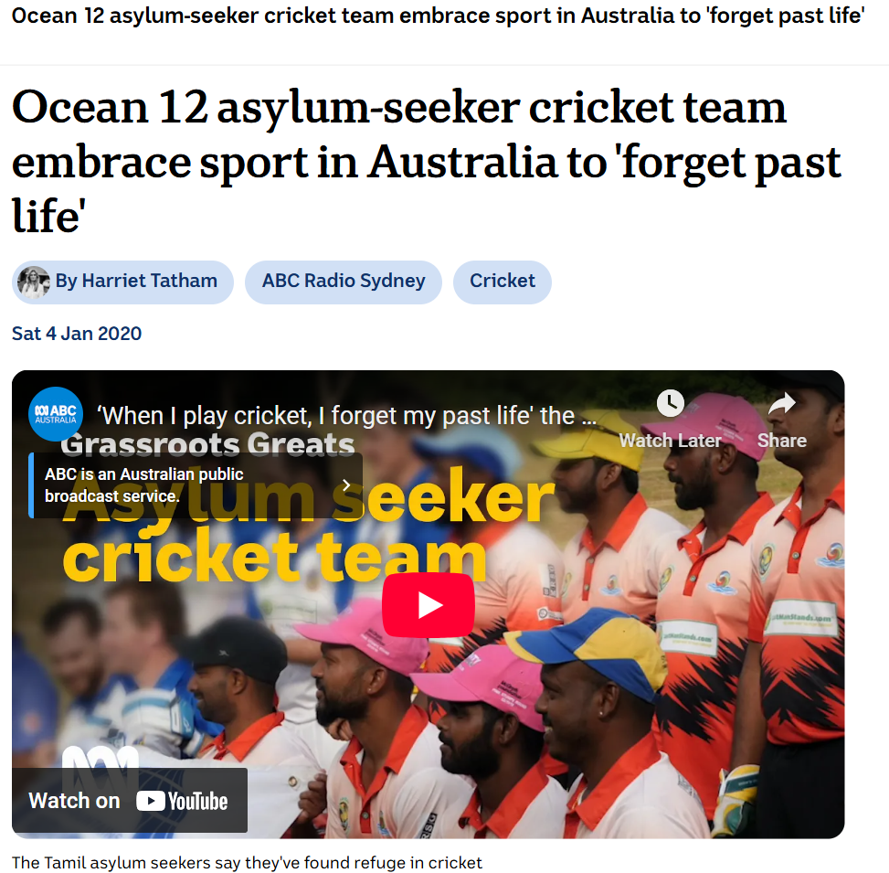
Multiple grounds – BAK18 v Minister for Home Affairs (2020) 274 FCR 268
Common law grounds (only one successful ground required)
BAK18 wife and children, Tamils, sought protection visas, for fear of persecution in Sri Lanka
Minister refused, reviewed by Immigration Assessment Authority (IAA), affirmed refusal.
Grounds
IAA had refused to consider new evidence (captaincy of a Tamil cricket team which suggested was Tamil) failed on ground of materiality;
Secretary failed to provide material to IAA re: mother and brother and the basis on which they had been granted protection visas (similar situation). Successful and this was a jurisdictional error; and not providing material was unreasonable. This argument was not considered.
Administrative Law –LAW1023

Slide 26
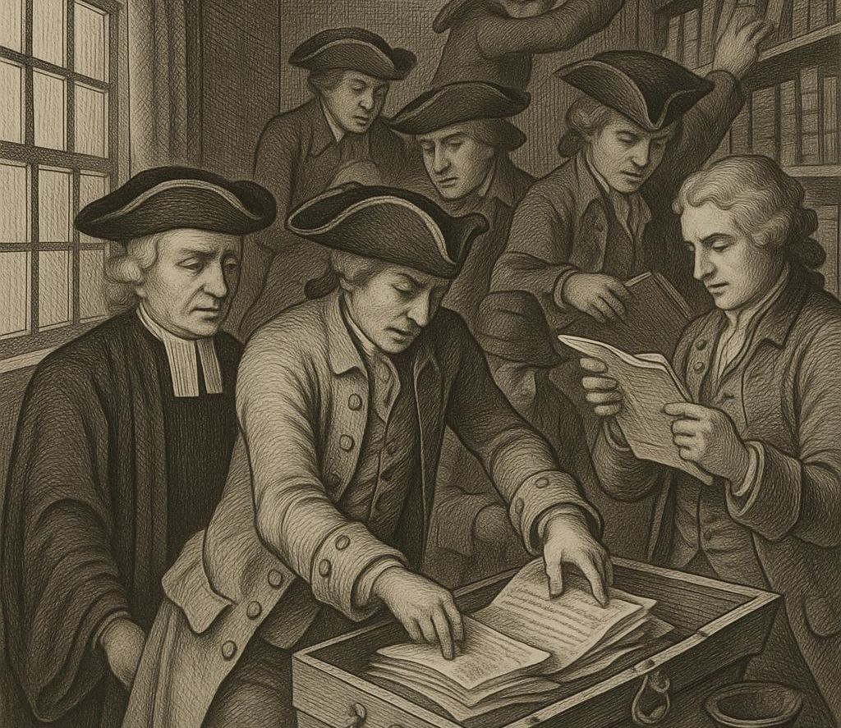

Acting beyond power ( misconceiving the scope of the power)
The basic principle that all government action must be sourced in law applies to administrative acts as well as the making of delegated legislation. Both common law and ADJR Act ground, s 5(1)(d) – ‘that the decision was not authorised by the enactment in pursuance of which it was purported to be made’
Entick v Carrington (1765) 19 St Tr 1030 Secretary of State issued search warrant for seditious material against Mr Entick. Sued for trespass and won. All government action must be sourced in law; especially if it affects rights such as private property. Lord Camden CJ: rights preserved unless taken away ‘by some public law for the good of the whole’ in this case no such law existed.
A v Hayden (No 2) (1984) 156 CLR 532 ASIS officers not authorised to commit criminal offences, without express statutory exemption from prosecution. Crown in the past had ‘dispensing power’ but HCA said its danger had been recognised and it had been fully abolished by 1689 Bill of Rights.
Administrative Law –LAW1023

Slide 27
Questions
4. What is a procedural error?
a. Consider (once more) Project Blue Sky v ABA (1998) 194 CLR 355
i. What were the facts?
ii. What was the outcome?
iii. How does one determine whether a procedural error leads to an invalid decision?
5. What is delegation?
a. What is the common law assumption? maxim delegatus non potest delegare (“a delegate cannot delegate”)
b. What kind of statutory interpretation principles should guide this process?
Notes:
Australia no bill of rights
Extra important admin law often only avenue of redress

Slide 28
Questions
c. Consider Ex parte Forster, Re University of Sydney [1963] SR 723
i. What was at issue?
ii. What was held?
iii. Compare this with Griffith University v Tang 221 CLR 99
d. What is the agency/alter ego principle?
i. Consider Carltona v Commissioners of Works [1943] 2 All ER 560
1. What were the facts?
2. What was held?
3. Compare this with other cases
Notes:
Australia no bill of rights
Extra important admin law often only avenue of redress

Slide 29


Procedural requirements
Project Bluesky (again)
Facts: Australian Broadcasting Authority (ABA) required to make
program standards re: Australian content (s.122 Broadcasting Services Act 1992 (Cth)).
s160 Act – ABA to perform functions in manner consistent with (d) Australia’s intl obligations (conventions or agreements with other countries)
ABA - content standard requiring TV networks to have Aust content of 50-55%
Project Blue Sky company (NZ) made shows including ‘Xena Warrior Princess’ (pictured): ABA’s content standard inconsistent with protocol made under a trade agreement (‘no less favourable’ treatment provision)
Q: was failure to follow s160(d) a procedural requirement, breach of which would lead to invalidity of the content standard made under s.122?
Administrative Law –LAW1023

Slide 30
Procedural Ultra Vires – Project Blue Sky - McHugh, Gummow, Kirby and Hayne J
HCA held (per McHugh, Gummow, Kirby and Hayne JJ):
‘An act done in breach of a condition regulating the exercise of a statutory power is not necessarily invalid and of no effect.’
Criticised traditional mandatory/directory distinction…
Instead, should look to parliamentary intention:
(i) Language of the statute
(ii) Subject matter and objects of statute
(iii) Consequences to the parties of a finding that actions done in breach of the condition are void
NB ‘no decisive rule’ – ‘contestable judgment’. In this case, s 160 directed to policy guidance for ABA – impossible in practice to have regard to 900+ treaties to which Australia is party – much inconvenience if many acts of ABA (eg grants of licences) were invalidated – court found no Parl. intention that breach should lead to invalidity. Still, foreign producers could sue
for breach of s 160, and effect was threat to local content.
NB Brennan CJ dissented, holding Standard invalid
Administrative Law –LAW1023

Slide 31
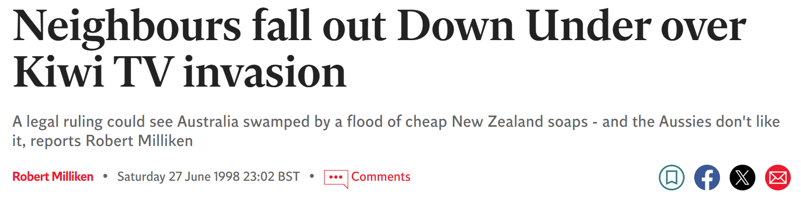

Aftermath of Project Blue Sky Decision
Letter from Australian actors to John Howard: http://www.independent.co.uk/news/neighbours-fall-out-down-under-over-kiwi-tv-invasion-1168190.html
Parliament Inquiry – Government responded by limiting application of PBS ruling to NZ only
This is still the case: See Australian Content Standard: https://www.legislation.gov.au/Details/F2016L00392
…which recognises NZ programs in s 5(3):
‘While Australian culture and New Zealand culture are different from each other, in order to be consistent with the Protocol on Trade in Services to the Australia New Zealand Closer Economic Relations Trade Agreement, this standard recognises New Zealand programs and Australia/New Zealand programs equally with Australian programs for the purposes of compliance with this standard’.
Administrative Law –LAW1023

Slide 32
Application of PBS Decision – Migration Cases
SAAP v Minister Immigration (2005) HCA 24
  Section 424A Migration Act – information used to reach decision must be provided to applicant in writing
  Refugee Review Tribunal – gave oral comment rather than written comment on evidence used
  HCA held – breach of s 424A, given importance of s 424A obligation in scheme of Act this constitutes an invalid decision (see eg Hayne J – mandatory language used by Parliament, ‘must’, plus context)
Minister Immigration v SZIZO (2009) HCA 37
  Section 441G Migration Act – authorised recipient to receive docs
  HCA held: Here failure to notify authorised recipient did not lead to unfairness or denial of natural justice as the applicant attended hearing and make submissions after; decision still valid. The notification was not important in itself but only to ensure that these things took place.
Administrative Law –LAW1023

Slide 33

Improper Delegation – agency/alter ego
Agency/alter ego principle
Common law recognises that in certain cases, agents can act in name of principal
Difference between delegation and agency:
Delegation: person (delegate) acts in their own name (see Re Reference under s 11 Ombudsman Act for example of delegate failing to act (sign) in own name as required by statute;
Agency/alter ego principle: junior person acts in name of the superior (eg ‘Mary Jones, on behalf of the Minister’ – see eg O’Reilly case discussed below)
Administrative Law –LAW1023

Slide 34

Improper Delegation – agency/alter ego
Carltona v Commissioners of Works [1943] 2 All ER 560
Facts: Carltona owned fruit-packaging factory.
World War II - Minister of Works took over the factory in the national interest
Defence (General) Regulations 1939 - ‘competent authority’ (included Commissioner of Works and Planning Minister) could requisition land in national interest
Letter to Carltona: signed by ‘Mr Morse on behalf of the Minister’ (officer in Planning Dept)
Carltona argued this decision was UV - Morse not ‘competent authority’ under the statute
Administrative Law –LAW1023

Slide 35
Question: Breakout Groups
Identify the key principle in the following cases:
Shanahan v Scott (1957) 96 CLR
Foley v Padley (1984) 154 CLR 349
And others…. See canvas materials.
Administrative Law –LAW1023

Slide 36

Case Study: Victorian Police
Acting assistant commissioners swore in recruits over eight years despite being unauthorised to do so, leaving the force to re-swear in more than 1000 officers.
The error arose when changes were made to the Victoria Police Act in 2013, which meant acting assistant commissioners were appointed without the required power.
Also drink drive hearings - in 2015 when lower ranking commissioners had been signing off on the credentials of breath-test operators without the authority to do so.
For about eight months the certificates issued to legalise the use of evidentiary breath-testing machines – inside booze buses and police stations – in prosecuting offenders were invalid.
Retrospective legislation was passed to legalise the breath tests.
Administrative Law –LAW1023

Slide 37
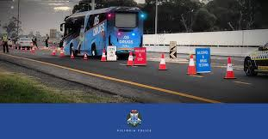
Case Study: Victorian Police
Issue - That other police operations could be affected by the delegation issue?
The delegation problem for Victoria Police did not invalidate arrests (because even citizens can arrest) but has created a range of problems with the exercise of any power by a 'police officer' who is not properly been given the power, such as search warrants (and hence the real possibility of non-admissible evidence )
Please see this link: Police issue raised in 2015, says former prosecutor
Administrative Law –LAW1023

Slide 38
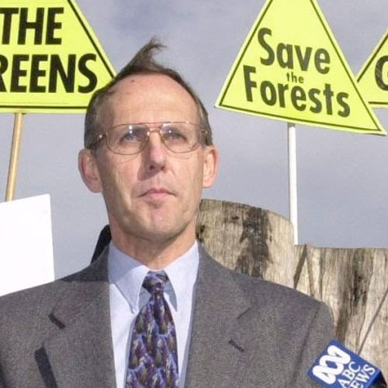
Case Study: Illegal Logging
Bob Brown Foundation argues that all logging in Tasmania has been carried out illegally for decades which also casts doubt on the convictions of hundreds of people charged in conservation protests.
There was a deficiency in a delegation made under the Forest Prac­tices Act. This came to light during court action against nine anti forestry protesters. Dr Bob Brown was one of the protesters that had the charges dropped.
The legislation has been in place since 1985. Section 43 of the Act allows the Forest Practices Authority to delegate “any of its functions or powers other than this power of ­delegation”.
https://todayspaper.themercury.com.au/infinity/article_popover_share.aspx?guid=87ec3cb6-9b21-4541-bc52-4a49e47978d0
Administrative Law –LAW1023

Slide 39
Case Study: Illegal Logging
Bob Brown Foundation argues that all logging in Tasmania has been carried out illegally for decades which also casts doubt on the convictions of hundreds of people charged in conservation protests.
There was a deficiency in a delegation made under the Forest Prac­tices Act. This came to light during court action against nine anti forestry protesters. Dr Bob Brown was one of the protesters that had the charges dropped.
The legislation has been in place since 1985. Section 43 of the Act allows the Forest Practices Authority to delegate “any of its functions or powers other than this power of ­delegation”.
https://todayspaper.themercury.com.au/infinity/article_popover_share.aspx?guid=87ec3cb6-9b21-4541-bc52-4a49e47978d0
Administrative Law –LAW1023

Slide 40

Case Study: Ministerial Discretion
Djokovic v Minister for Immigration, Citizenship, Migrant Services and Multicultural Affairs [2022] FedCFamC2G 7
Exercise of power conferred by s 133C(3) of Migration Act (where Minister for Immigration makes decision to cancel applicant’s visa)
Are their preconditions to the exercise of discretion?
Can the minister be satisfied it is in the public interest to cancel the visa under s116 Migration Act?
Judge Kelly at [58] ministerial satisfaction respecting the matters in each limb of s 133C(3)(a) and (b) is essential to the existence of the Minister’s statutory discretionary personal power to consider cancellation….. In each case, the nature of the satisfaction of the Minister that is necessary and sufficient to engage the power in s 133C(3) “is a state of mind formed reasonably and on a correct understanding and application of the applicable law.”
Source: Wikicommons
Administrative Law –LAW1023

Slide 41
—
Questions?
Email
richard.taylor2@rmit.edu.au

